Slide 1
Biathlon Competition

Slide 2
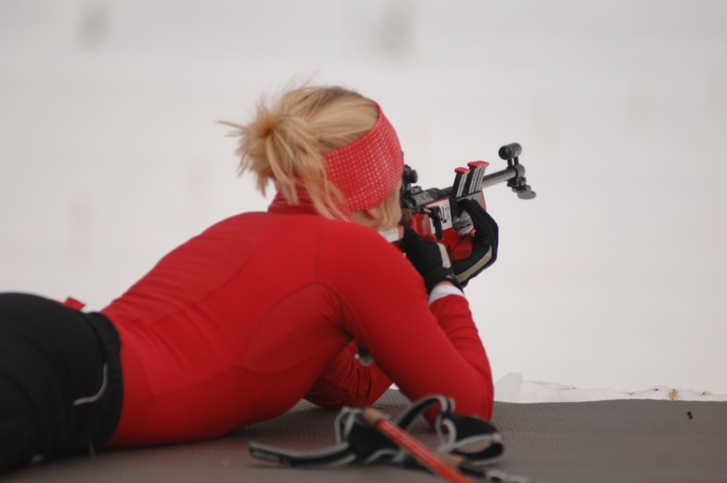
Call for Barents Biathlon Match 2014
Barents Winter Games 2014 - Biathlon
Tromsø April 4th-6th

Slide 3
The 2014 Barents Winter Games will take place in Tromsø
Tromsø Biathlon Team (TBT) is honoured to be the host and welcome you
to the Barents Winter Games - Biathlon Match 2014. TBT is one of the largest biathlon teams in the
Northern Norway and the shooting field is located close to the airport, city centre, shopping malls and hotels. Many high-ranked biathletes and cross country skiers live in the city.
We thank The Barents our sponsors, volunteers and the municipality for help and funding to arrange this biathlon event.
We sincerely hope that your stay in Tromsø will be pleasant and
that the stay will fulfil your expectations. It is our hope that this event
will contain good sportsmanship and fair conditions.
We hereby welcome the teams from northern Russia, Finland and Sweden
to participate in this Barents Biathlon Match.

Slide 4
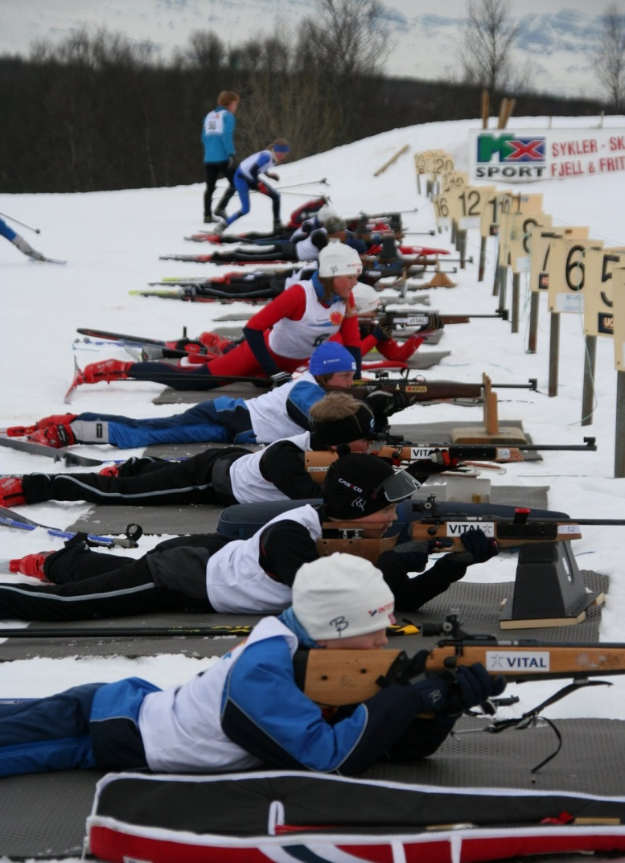
General Information
Organizing committee
Eirik Blix
Johanne Raade
Kjersti Strand
Competition committee
Kent-Eirik Gerhardsen, Competition Chief
Steinar Vaadal, Chief of Stadium
John Thorstensen, Chief of Shooting Range
Johanne Raade, Chief of Secretary
Eirik Blix, Chief of Timing
Yngve Vassmyr, Chief of Course
Officials
NN, Technical Delegate
NN, Technical Delegate

Slide 5
General Information
Tromsø is an island, city and municipality in Troms county, Norway. The administrative center of the municipality is the city of Tromsø. Tromsø city is the largest urban area in North Norway.
The area has been inhabited since the end of the ice age (9000 BC), and the Sámi culture is the first known culture of the region besides the Norrons. Speakers of Norse, the ancestor of Norwegian, brought their culture to the area during the migrations of the Vikings before year 890, when Ohthere's settlement existed to the south of today's Tromsø. The first church on the island of Tromsøya was built in year 1252. The area was one of Denmark-Norway's very northernmost territories. During the 1600s, Denmark-Norway solidified its claim to the northern coast of Scandinavia and during this period a redoubt, Skansen, was built. Tromsø was issued its city charter in 1794 by King Christian VII. The city was established as a municipality 1 January 1838. The population of Tromsø municipality is 67 091 per October 2009. See: http://www.tromso.kommune.no/information-in-english.147134.no.html
Biathlon
The Tromsø Biathlon Team (TBT) was established in 1984 had its 25th year jubilee last year. From being a rather small team, TBT has evolved to be the largest biathlon team in the northern Norway. TBT has hosted both a National Championship (seniors) and numerous other competitions since it was founded. A number of high-ranked biathletes live in Tromsø where they train at TBT´s shooting range at daily basis.

Slide 6
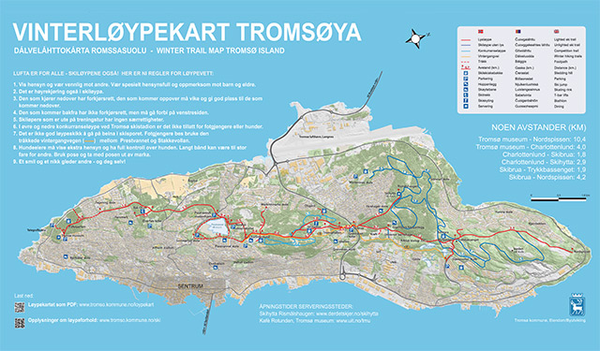
General Information
Venue
The stadium has 25 targets that are roofed and lighted. The snow is normaly natural snow, and the tracks/courses close to the shooting range are well lit and are usually open to 11.30 pm. The map below show cross country courses at the Tromsø island. For more details about the competition courses, please see: www.tssl.no
Map url: http://www.tromso.kommune.no/loeypekart.123110.no.html

Slide 7
Contact Infomation
Contact information
Kent-Eirik Gerhardsen, Chief of Competition
Eirik Blix, Coordinator
Johanne Raade, Chief of Secretary
Website: www.tssl.no
E-mail: tromso.skiskytter.lag@gmail.com
Barents Winter Games: http://www.barentsgames.no/
Address
Tromsø Skiskytterlag
Alvevegen 170
v/ Kent-Eirik Gerhardsen
N-9016 TROMSØ
Norway
Competition office
The competition office is located at the Biathlon Stadium.
Hours of operation will be announced closer to the competition.
Registration/Entry:
Tromso.skiskytter.lag@gmail.com
With copy to: johanne.raade@gmail.com and eirik.blix@facilit.no

Slide 8
General Information
Accommodation
Will be coordinated by troms@idrettsforbundet.no
Dressing room/wardrobes and showers
Accessible close to the stadium
Waxing cabins
Unfortunately the TBT will not provide waxing cabins/will be located at the stadium
Weather forecast
The weather forecast can be assessed from:
http://www.yr.no/place/Norway/Troms/Troms%C3%B8/Troms%C3%B8/
Actual temperature, humidity and wind speed/direction can be viewed at:
http://weather.cs.uit.no/
Web camera at the stadium
http://www.tromsoskiklubb.no/langrenn/WEBCAM.htm
Normal temperature and precipitation for Tromsø (1961-1990)
April: +0.3 °C and 64 mm

Slide 9
General Information
Liability/Insurance
All participants must have signed a sufficient accident, illness and liability insurance.
VISA regulations for Russian participants
To obtain a VISA please contact the Norwegian Embassy of you home country. If you need any
assistance obtaining your VISA (e.g. venue confirmation), please contact the
Chief of Secretary no later than April 1st.
Import and export of rifles and ammunition
Please contact your local police authority. All rifles and ammunition must be under constant
surveillance or locked in securely during the stay in Norway.
Rules and regulations during competition
Competition rules is in accordance with the Norwegian Biathlon Federation and
are in most instances equal to IBU, see
http://www.skiskyting.no/filestore/Regler/RevisjonNasjonalekonkurransereglerjuli2013.pdf (in Norwegian)
http://www.biathlonworld.com/media/files/downloads/IBU_Rules_2012_cap3.pdf

Slide 10
Event schedule
Friday 4th Arrival and accommodation
14.00-17.00 Official training
18.00 Team Captain meeting at hotel (election of jury)
Saturday 5th 09.30-10.45 Zeroing Sprint
11.30 First start sprint
Sunday 6th 09.30-10.45 Zeroing Mass start
11.30 First start Mass start
Course maps, start lists and results will be accessible at:
www.tssl.no
Any changes will be announced at the web site!

Slide 11
Saturday april 5th Classes and course lengths; Sprint
Women Course approx. Posisition Penalty
14/15 yrs (*) 4,5 km (1.5km + 1,5km + 1.5km) prone-prone 100m
16/17 yrs (*) 6 km (2km + 2km + 2km) prone-standing 150m
18/19 yrs 6 km (2km + 2km + 2km) prone-standing 150m
20/21 yrs 7 km (2km + 2km + 3km) prone-standing 150m
Men
14/15 yrs (*) 5 km (1,5km + 1,5km + 2km) prone-prone 100m
16/17 yrs (*) 7 km (2km + 2km + 3km) prone-standing 150m
18/19 yrs 7 km (2km + 2km + 3km) prone-standing 150m
20/21 yrs 9 km (3km + 3km + 3km) prone-standing 150m
(*) Rifles fixed on mats for 14/15 yrs and 16/17 yrs
www.tssl.no
Any changes will be announced at the web site!

Slide 12
Sunday april 6th Classes and course lengths; Mass start
Women Course approx. Posisition Penalty
14/15 yrs (*) 4,5 km (1.5km + 1,5km + 1.5km) prone-prone 100m
16/17 yrs (*) 7,5 km (1.5km+1,5km+1.5km+1,5km+1.5km) prone-prone-standing-standing 150m
18/19 yrs 7,5 km (1.5km+1,5km+1.5km+1,5km+1.5km) prone-prone-standing-standing 150m
20/21 yrs 10 km (2km+2km+2km+2km+2km) prone-prone-standing-standing 150m
Men
14/15 yrs (*) 5 km (1,5km + 1,5km + 2km) prone-prone 100m
16/17 yrs (*) 10 km (2km+2km+2km+2km+2km) prone-prone-standing-standing 150m
18/19 yrs 10 km (2km+2km+2km+2km+2km) prone-prone-standing-standing 150m
20/21 yrs 12 km (3km+2km+2km+2km+3km) prone-prone-standing-standing 150m
(*) Rifles fixed on mats for 14/15 yrs and 16/17 yrs
www.tssl.no
Any changes will be announced at the web site!

